Slide 1


CISC450 Computer Networks
Lesson 9
Local Area Networks
Slides courtesy of
William Stallings

Slide 2
Protocol Architecture
Lower layers of OSI model
IEEE 802 reference model
Physical
Logical link control (LLC)
Media access control (MAC)

Slide 3
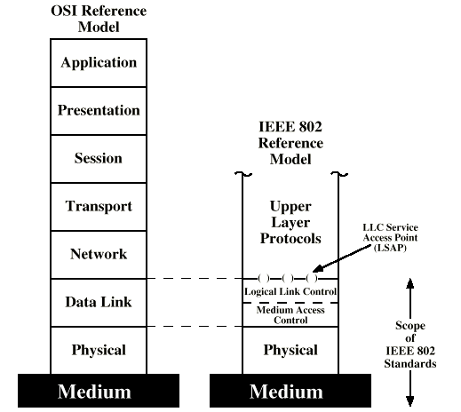
IEEE 802 v OSI

Slide 4
802 Layers -
Physical
Encoding/decoding
Preamble generation/removal
Bit transmission/reception
Transmission medium and topology

Slide 5
802 Layers -
Logical Link Control
Interface to higher levels
Flow and error control

Slide 6
802 Layers -
Media Access Control
Assembly of data into frame with address and error detection fields
Disassembly of frame
  Address recognition
  Error detection
Govern access to transmission medium
  Not found in traditional layer 2 data link control
For the same LLC, several MAC options may be available

Slide 7
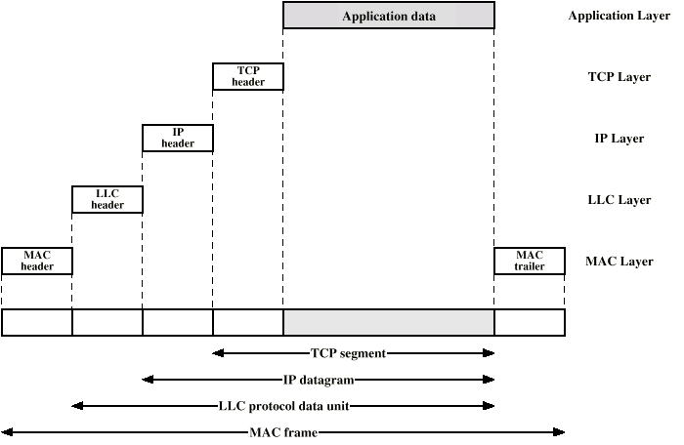
LAN Protocols in Context

Slide 8
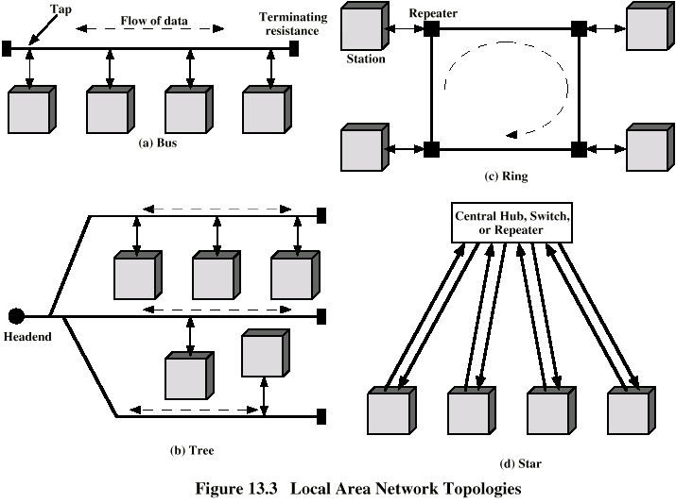
LAN Topologies

Slide 9
Bus and Tree
Multipoint medium
Transmission propagates throughout medium
Heard by all stations
  Need to identify target station
    Each station has unique address
Full duplex connection between station and tap
  Allows for transmission and reception
Need to regulate transmission
  To avoid collisions
  To avoid hogging
    Data in small blocks - frames
Terminator absorbs frames at end of medium

Slide 10
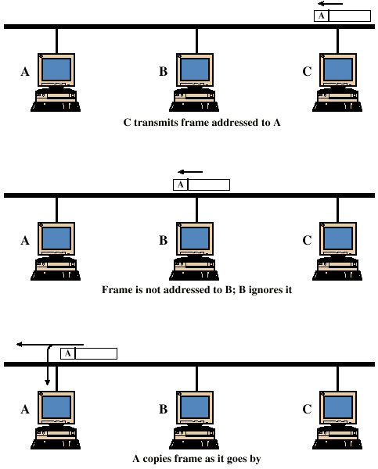
Frame Transmission - Bus LAN

Slide 11
Ring Topology
Repeaters joined by point to point links in closed loop
  Receive data on one link and retransmit on another
  Links unidirectional
  Stations attach to repeaters
Data in frames
  Circulate past all stations
  Destination recognizes address and copies frame
  Frame circulates back to source where it is removed
Media access control determines when station can insert frame

Slide 12
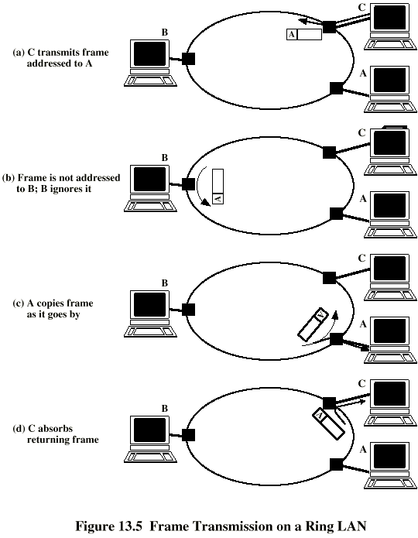
Frame
Transmission
Ring LAN

Slide 13
Star Topology
Each station connected directly to central node
  Usually via two point to point links
Central node can broadcast
  Physical star, logical bus
  Only one station can transmit at a time
Central node can act as frame switch

Slide 14
Media Access Control
Where
  Central
    Greater control
    Simple access logic at station
    Avoids problems of co-ordination
    Single point of failure
    Potential bottleneck
  Distributed
How
  Synchronous
    Specific capacity dedicated to connection
  Asynchronous
    In response to demand

Slide 15
Asynchronous Systems
Round robin
  Good if many stations have data to transmit over extended period
Reservation
  Good for stream traffic
Contention
  Good for bursty traffic
  All stations contend for time
  Distributed
  Simple to implement
  Efficient under moderate load
  Tend to collapse under heavy load

Slide 16
MAC Frame Format
MAC layer receives data from LLC layer
MAC control
Destination MAC address
Source MAC address
LLS
CRC
MAC layer detects errors and discards frames
LLC optionally retransmits unsuccessful frames

Slide 17
Logical Link Control
Transmission of link level PDUs between two stations
Must support multiaccess, shared medium
Relieved of some link access details by MAC layer
Addressing involves specifying source and destination LLC users
  Referred to as service access points (SAP)
  Typically higher level protocol

Slide 18
LLC Services
Based on HDLC
Unacknowledged connectionless service
Connection mode service
Acknowledged connectionless service

Slide 19
LLC Protocol
Modeled after HDLC
Asynchronous balanced mode to support connection mode LLC service (type 2 operation)
Unnumbered information PDUs to support Acknowledged connectionless service (type 1)
Multiplexing using LSAPs

Slide 20
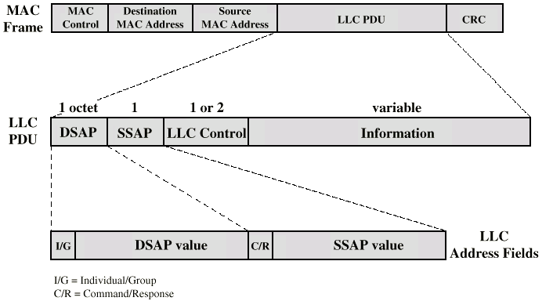
Typical Frame Format

Slide 21
Bus LANs
Signal balancing
  Signal must be strong enough to meet receiver’s minimum signal strength requirements
  Give adequate signal to noise ration
  Not so strong that it overloads transmitter
  Must satisfy these for all combinations of sending and receiving station on bus
  Usual to divide network into small segments
  Link segments with amplifies or repeaters

Slide 22
Transmission Media
Twisted pair
  Not practical in shared bus at higher data rates
Baseband coaxial cable
  Used by Ethernet
Broadband coaxial cable
  Included in 802.3 specification but no longer made
Optical fiber
  Expensive
  Difficulty with availability
  Not used
Few new installations
  Replaced by star based twisted pair and optical fiber

Slide 23
Baseband Coaxial Cable
Uses digital signaling
Entire frequency spectrum of cable used
Single channel on cable
Bi-directional
Few kilometer range
Ethernet (basis for 802.3) at 10Mbps
50 ohm cable (10Base2, 10Base5)

Slide 24
10Base5 (Thicknet)
Ethernet and 802.3 originally used 0.4 inch diameter cable at 10Mbps
Max cable length 500m
Distance between taps a multiple of 2.5m
  Ensures that reflections from taps do not add in phase
Max 100 taps
10Base5

Slide 25
10Base2 (Thinnet)
AKA “Cheapernet”
0.25 inch cable
  More flexible
  Easier to bring to workstation
  Cheaper electronics
  Greater attenuation
  Lower noise resistance
  Fewer taps (30)
  Shorter distance (185m)
  Easier to break!

Slide 26
Repeaters
Transmits in both directions
Joins two segments of cable
No buffering
No logical isolation of segments
If two stations on different segments send at the same time, packets will collide
Only one path of segments and repeaters between any two stations

Slide 27
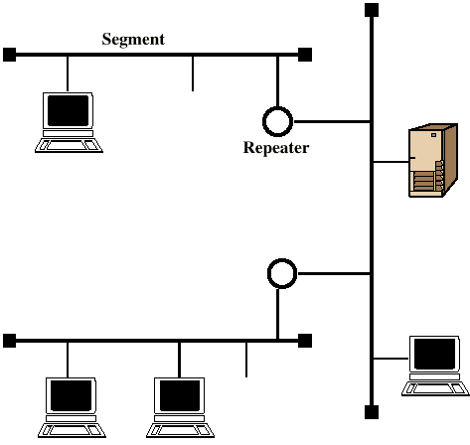
Baseband Configuration

Slide 28
Ring LANs
Each repeater connects to two others via unidirectional transmission links
Single closed path
Data transferred bit by bit from one repeater to the next
Repeater regenerates and retransmits each bit
Repeater performs data insertion, data reception, data removal
Repeater acts as attachment point
Packet removed by transmitter after one trip round ring

Slide 29
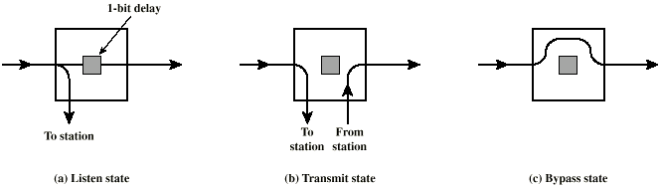
Ring Repeater States

Slide 30
Listen State Functions
Scan passing bit stream for patterns
  Address of attached station
  Token permission to transmit
Copy incoming bit and send to attached station
  Whilst forwarding each bit
Modify bit as it passes
  e.g. to indicate a packet has been copied (ACK)

Slide 31
Transmit State Functions
Station has data
Repeater has permission
May receive incoming bits
  If ring bit length shorter than packet
    Pass back to station for checking (ACK)
  May be more than one packet on ring
    Buffer for retransmission later

Slide 32
Bypass State
Signals propagate past repeater with no delay (other than propagation delay)
Partial solution to reliability problem (see later)
Improved performance

Slide 33
Ring Media
Twisted pair
Baseband coaxial
Fiber optic
Not broadband coaxial
  Would have to receive and transmit on multiple channels, asynchronously (too hard/expensive)

Slide 34
Potential Ring Problems
Break in any link disables network
Repeater failure disables network
Installation of new repeater to attach new station requires identification of two topologically adjacent repeaters
Timing jitter
Method of removing circulating packets required
  With backup in case of errors
Mostly solved with star-ring architecture

Slide 35
Star Ring Architecture
Feed all inter-repeater links to single site
  Concentrator
  Provides central access to signal on every link
  Easier to find faults
  Can launch message into ring and see how far it gets
  Faulty segment can be disconnected and repaired later
  New repeater can be added easily
  Bypass relay can be moved to concentrator
  Can lead to long cable runs
Can connect multiple rings using bridges

Slide 36
Star LANs
Use unshielded twisted pair wire (telephone)
  Minimal installation cost
    May already be an installed base
    All locations in building covered by existing installation
Attach to a central active hub
Two links
  Transmit and receive
Hub repeats incoming signal on all outgoing lines
Link lengths limited to about 100m
  Fiber optic - up to 500m
Logical bus - with collisions

Slide 37
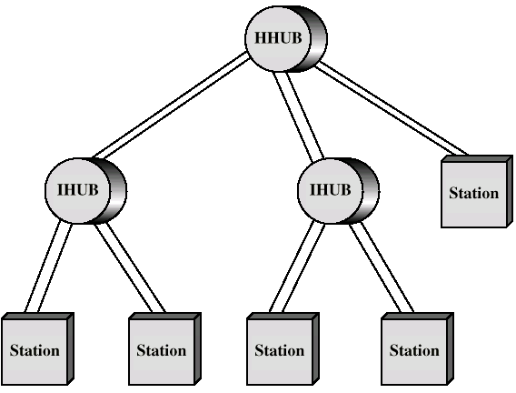
Two Level Star Topology

Slide 38
Hubs and Switches
Shared medium hub
  Central hub
  Hub retransmits incoming signal to all outgoing lines
  Only one station can transmit at a time
  With a 10Mbps LAN, total capacity is 10Mbps
Switched LAN hub
  Hub acts as switch
  Incoming frame switches to appropriate outgoing line
  Unused lines can also be used to switch other traffic
  With two pairs of lines in use, overall capacity is now 20Mbps

Slide 39
Switched Hubs
No change to software or hardware of devices
Each device has dedicated capacity
Scales well
Store and forward switch
  Accept input, buffer it briefly, then output
Cut through switch (Kalpana)
  Take advantage of the destination address being at the start of the frame
  Begin repeating incoming frame onto output line as soon as address recognized
  May propagate some bad frames

Slide 40
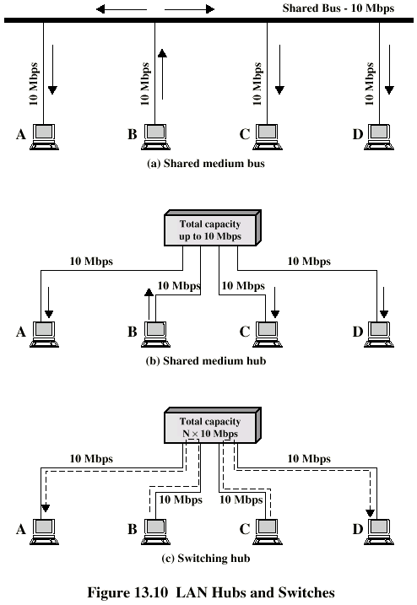
Hubs and
Switches (diag)

Slide 41
Bridges
Ability to expand beyond single LAN
Provide interconnection to other LANs/WANs
Use Bridge or router
Bridge is simpler
  Connects similar LANs
  Identical protocols for physical and link layers
  Minimal processing
Router more general purpose
  Interconnect various LANs and WANs
  see later

Slide 42
Why Bridge?
Reliability
Performance
Security
Geography

Slide 43
Functions of a Bridge
Read all frames transmitted on one LAN and accept those address to any station on the other LAN
Using MAC protocol for second LAN, retransmit each frame
Do the same the other way round

Slide 44
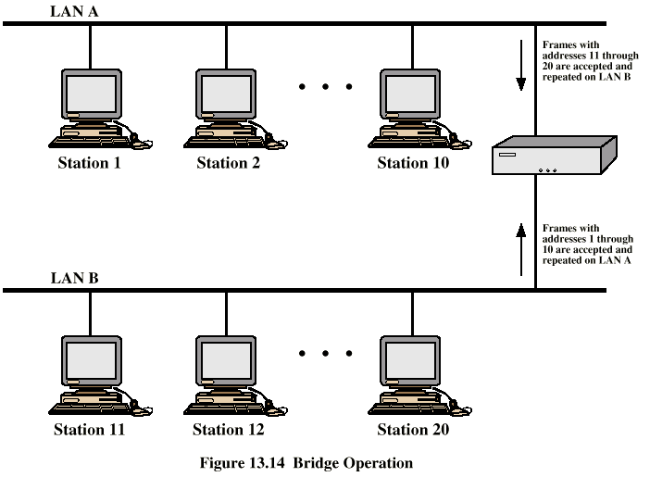
Bridge Operation

Slide 45
Bridge Design Aspects
No modification to content or format of frame
No encapsulation
Exact bitwise copy of frame
Minimal buffering to meet peak demand
Contains routing and address intelligence
  Must be able to tell which frames to pass
  May be more than one bridge to cross
May connect more than two LANs
Bridging is transparent to stations
  Appears to all stations on multiple LANs as if they are on one single LAN

Slide 46
Bridge Protocol Architecture
IEEE 802.1D
MAC level
  Station address is at this level
Bridge does not need LLC layer
  It is relaying MAC frames
Can pass frame over external comms system
  e.g. WAN link
  Capture frame
  Encapsulate it
  Forward it across link
  Remove encapsulation and forward over LAN link

Slide 47
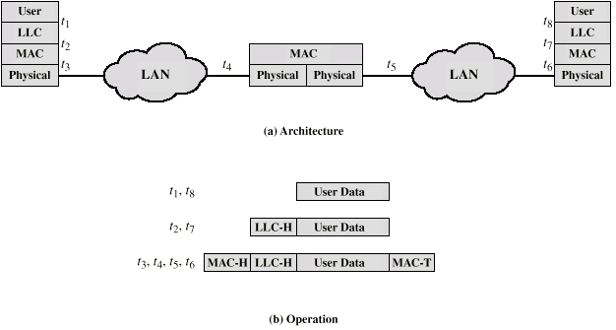
Connection of Two LANs

Slide 48
Fixed Routing
Complex large LANs need alternative routes
  Load balancing
  Fault tolerance
Bridge must decide whether to forward frame
Bridge must decide which LAN to forward frame on
Routing selected for each source-destination pair of LANs
  Done in configuration
  Usually least hop route
  Only changed when topology changes

Slide 49
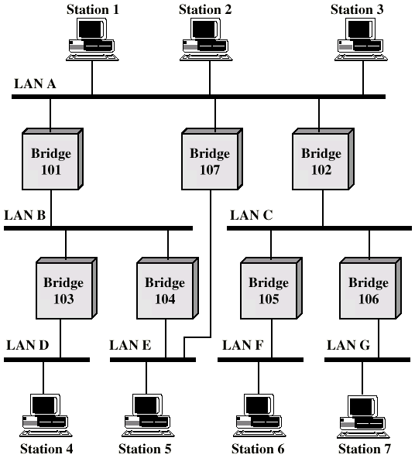
Multiple
LANs

Slide 50
Spanning Tree
Bridge automatically develops routing table
Automatically update in response to changes
Frame forwarding
Address learning
Loop resolution

Slide 51
Frame forwarding
Maintain forwarding database for each port
  List station addresses reached through each port
For a frame arriving on port X:
  Search forwarding database to see if MAC address is listed for any port except X
  If address not found, forward to all ports except X
  If address listed for port Y, check port Y for blocking or forwarding state
    Blocking prevents port from receiving or transmitting
  If not blocked, transmit frame through port Y

Slide 52
Address Learning
Can preload forwarding database
Can be learned
When frame arrives at port X, it has come form the LAN attached to port X
Use the source address to update forwarding database for port X to include that address
Timer on each entry in database
Each time frame arrives, source address checked against forwarding database

Slide 53
Spanning Tree Algorithm
Address learning works for tree layout
  i.e. no closed loops
For any connected graph there is a spanning tree that maintains connectivity but contains no closed loops
Each bridge assigned unique identifier
Exchange between bridges to establish spanning tree

Slide 54
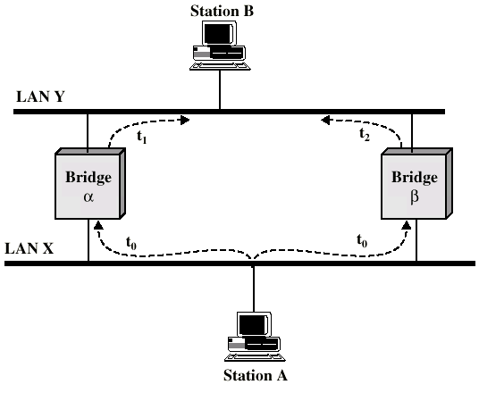
Loop of Bridges

Slide 55
Ethernet (CSAM/CD)
Carriers Sense Multiple Access with Collision Detection
Xerox – Ethernet (AKA, DIX)
IEEE 802.3

Slide 56
IEEE802.3 Medium Access Control
Random Access
  Stations access medium randomly
Contention
  Stations content for time on medium

Slide 57
ALOHA
Packet Radio
When station has frame, it sends
Station listens (for max round trip time)plus small increment
If ACK, fine. If not, retransmit
If no ACK after repeated transmissions, give up
Frame check sequence (as in HDLC)
If frame OK and address matches receiver, send ACK
Frame may be damaged by noise or by another station transmitting at the same time (collision)
Any overlap of frames causes collision
Max utilization 18%

Slide 58
Slotted ALOHA
Time in uniform slots equal to frame transmission time
Need central clock (or other sync mechanism)
Transmission begins at slot boundary
Frames either miss or overlap totally
Max utilization 37%

Slide 59
CSMA
Propagation time is much less than transmission time
All stations know that a transmission has started almost immediately
First listen for clear medium (carrier sense)
If medium idle, transmit
If two stations start at the same instant, collision
Wait reasonable time (round trip plus ACK contention)
No ACK then retransmit
Max utilization depends on propagation time (medium length) and frame length
  Longer frame and shorter propagation gives better utilization

Slide 60
If Busy?
If medium is idle, transmit
If busy, listen for idle then transmit immediately
If two stations are waiting, collision

Slide 61
CSMA/CD
With CSMA, collision occupies medium for duration of transmission
Stations listen whilst transmitting
If medium idle, transmit
If busy, listen for idle, then transmit
If collision detected, jam then cease transmission
After jam, wait random time then start again
  Binary exponential back off

Slide 62
Collision Detection
On baseband bus, collision produces much higher signal voltage than signal
Collision detected if cable signal greater than single station signal
Signal attenuated over distance
Limit distance to 500m (10Base5) or 200m (10Base2)
For twisted pair (star-topology) activity on more than one port is collision
Special collision presence signal

Slide 63
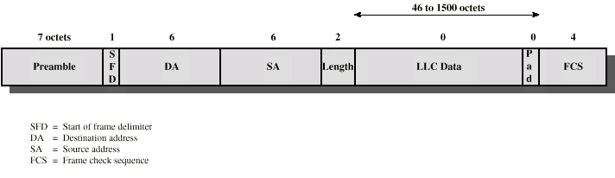
IEEE 802.3 Frame Format

Slide 64
10Mbps Specification (Ethernet)
<data rate><Signaling method><Max segment length>
10Base5 10Base2 10Base-T 10Base-FP
Medium Coaxial Coaxial UTP 850nm fiber
Signaling Baseband Baseband Baseband Manchester
Manchester Manchester Manchester On/Off
Topology Bus Bus Star Star
Nodes 100 30 - 33

Slide 65
100Mbps (Fast Ethernet)
100Base-TX 100Base-FX 100Base-T4
2 pair, STP 2 pair, Cat 5UTP 2 optical fiber 4 pair, cat 3,4,5
MLT-3 MLT-3 4B5B,NRZI 8B6T,NRZ

Slide 66
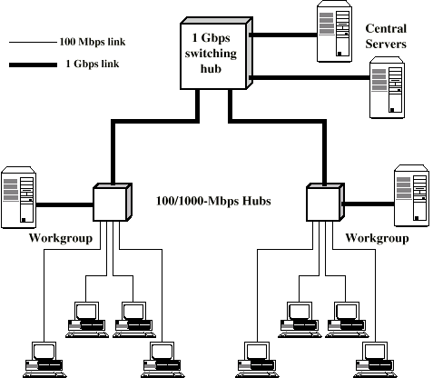
GigE
Config

Slide 67
Gigabit Ethernet - Differences
Carrier extension
At least 4096 bit-times long (512 for 10/100)
Frame bursting

Slide 68
Gigabit Ethernet - Physical
1000Base-SX
  Short wavelength, multimode fiber
1000Base-LX
  Long wavelength, Multi or single mode fiber
1000Base-CX
  Copper jumpers <25m, shielded twisted pair
1000Base-T
  4 pairs, cat 5 UTP
Signaling - 8B/10B

Slide 69
Token Ring (802.5)
MAC protocol
  Small frame (token) circulates when idle
  Station waits for token
  Changes one bit in token to make it SOF for data frame
  Append rest of data frame
  Frame makes round trip and is absorbed by transmitting station
  Station then inserts new token when transmission has finished and leading edge of returning frame arrives
  Under light loads, some inefficiency
  Under heavy loads, round robin

Slide 70
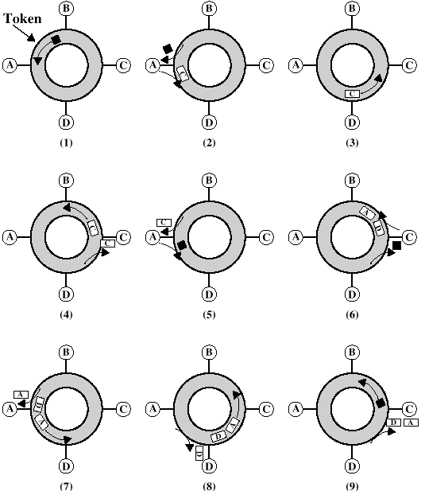
Token Ring
Operation

Slide 71
Dedicated Token Ring
Central hub
Acts as switch
Full duplex point to point link
Concentrator acts as frame level repeater
No token passing

Slide 72
802.5 Physical Layer
Data Rate 4 16 100
Medium UTP,STP,Fiber
Signaling Differential Manchester
Max Frame 4550 18200 18200
Access Control TP or DTR TP or DTR DTR
Note: 1Gbit in development

Slide 73
FDDI
100Mbps
LAN and MAN applications
Token Ring

Slide 74
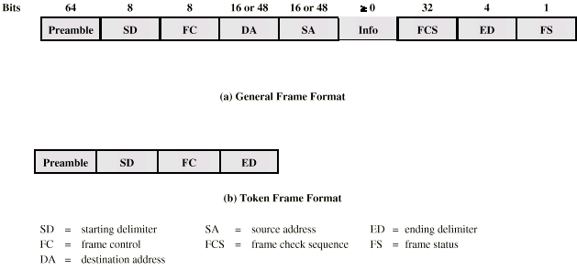
FDDI MAC Frame Format

Slide 75
FDDI MAC Protocol
As for 802.5 except:
Station seizes token by aborting token transmission
Once token captured, one or more data frames transmitted
New token released as soon as transmission finished (early token release in 802.5)

Slide 76
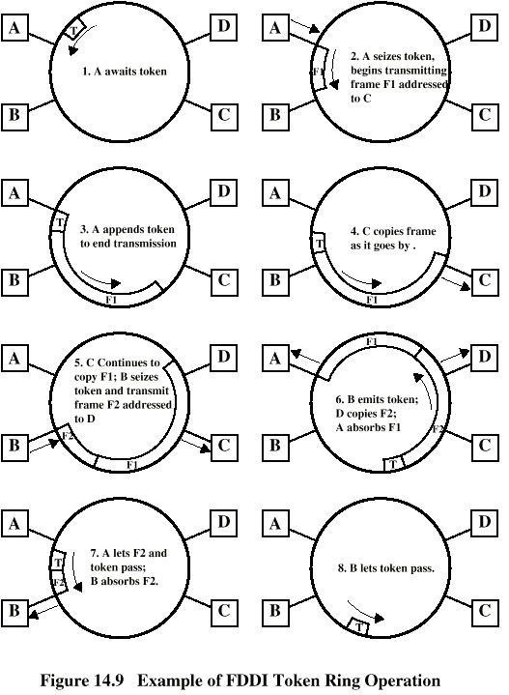
FDDI
Operation

Slide 77
FDDI Physical Layer
Medium Optical Fiber Twisted Pair
Data rate 100 100
Signaling 4B/5B/NRZI MLT-3
Max repeaters 100 100
Between repeaters 2km 100m

Slide 78
LAN Generations
First
  CSMA/CD and token ring
  Terminal to host and client server
  Moderate data rates (4-10-16 Mbps)
Second
  FDDI (100 Mbps)
  Backbone
  High performance workstations
Third
  ATM (155/622 Mbps)
  Aggregate throughput and real time support for multimedia applications

Slide 79
Third Generation LANs
Support for multiple guaranteed classes of service
  Live video may need 2Mbps
  File transfer can use background class
Scalable throughput
  Both aggregate and per host
Facilitate LAN/WAN internetworking

Slide 80
ATM LANs
Asynchronous Transfer Mode
Virtual paths and virtual channels
Preconfigured or switched
Gateway to ATM WAN
Backbone ATM switch
  Single ATM switch or local network of ATM switches
Workgroup ATM
  End systems connected directly to ATM switch
Mixed system

Slide 81
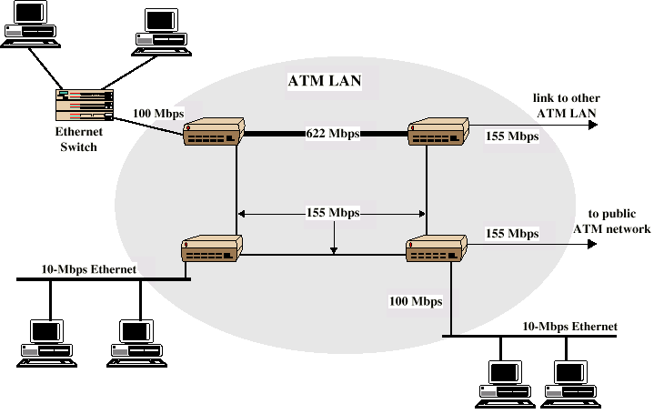
Example ATM LAN

Slide 82
Compatibility
Interaction between end system on ATM and end system on legacy LAN
Interaction between stations on legacy LANs of same type
Interaction between stations on legacy LANs of different types

